Slide 1
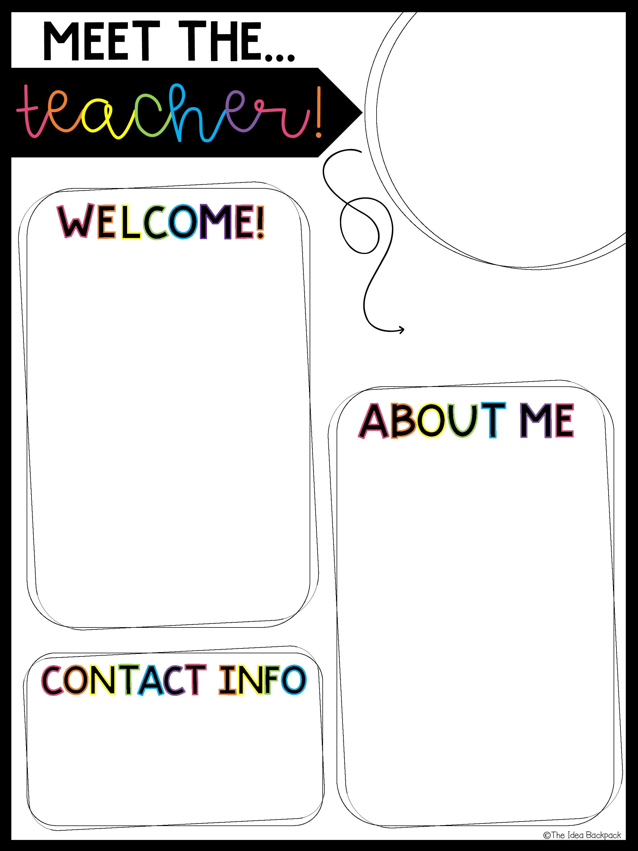

Welcome back to the 2020-2021 school year! My name is Ms. Christine Fara and I will be your Resource teacher this year! I am so excited to meet you all! During remote learning we will be meeting through Microsoft teams each day. I will be working closely with your teachers to assist you in your academics as we transition into our new way of learning. Please don’t hesitate to reach out to me via Microsoft teams whenever you need!
Mrs. Fara
These are a few of my favorite things!
Animal: Dogs…love Yorkies!
Book: James and the Giant Peach
Hobby: Baking
Color: Pink & Teal
Email: cfara@yonkerspublicschools.org
Phone: 914-376-8500
914-376-8300

